Slide 1
Speech Enhancement
in Edge Devices
2023/12/04
報告人: 賴彥廷

Slide 2
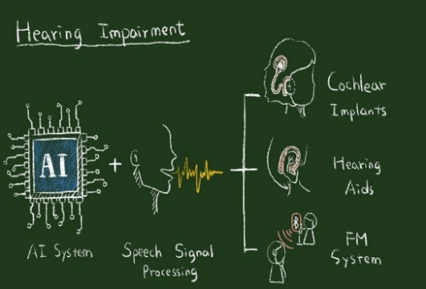
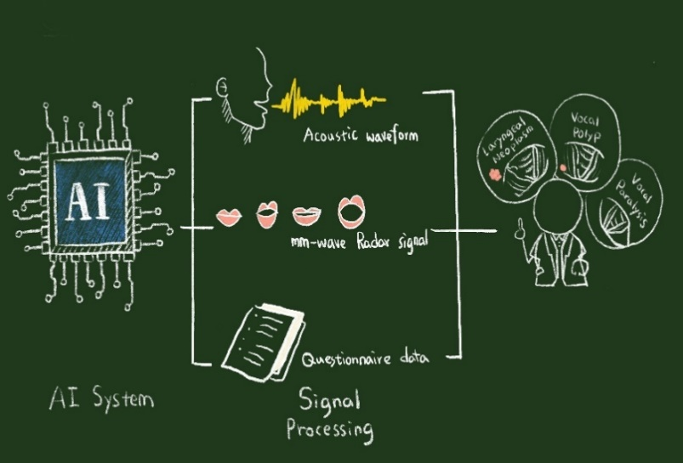
What is Speech Enhancement?
Removal of environmental noise from audio signals
Audio output noise cancellation
Hearing aid signal denoising
Cochlear implant denoising

Slide 3
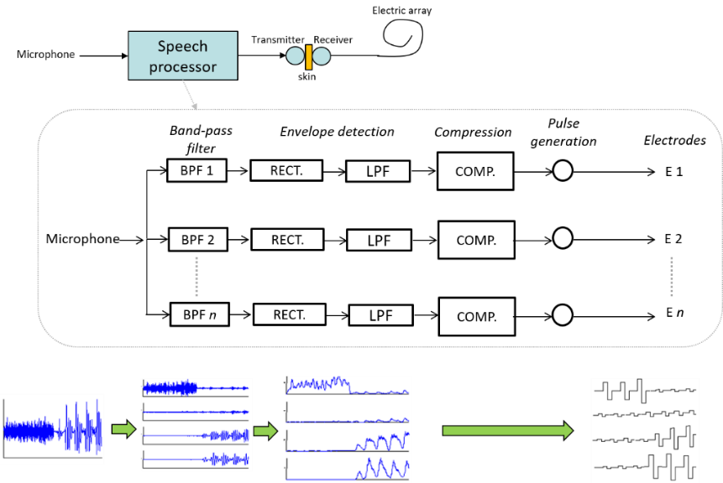
Cochlear Implants

Slide 4
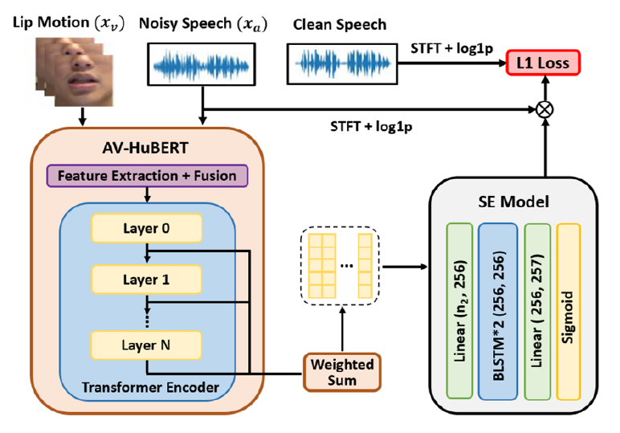
AVSE-SSL
STFT: Short Time Fourier Transform
BLSTM: Bidirectional Long Short-Term Memory
HuBERT: Hidden Unit Bidirectional Encoder Representations from Transformers
Use of both audio and visual cues for speech enhancement

Slide 5
Example
Parameters
Audio sample rate: 16,000Hz
Train dataset: TMHINT (Taiwan Mandarin Hearing in Noise Test)
Number of Epochs: 200
Test noise type: Babycry_2dB
noisy
enhanced
clean

Slide 6
Results
AOSE: Audio Only Speech Enhancement
SSL-AVSE: Self-Supervised Learning
Audio-Visual Speech Enhancement

Slide 7
Recap
Methods: AVSE for feature extraction and BLSTM for speech enhancement
Steps: Separate video into image and audio, extract lip motion from video, then feed both into model
Results: AVSE-SSL has best quality, AVSE second, and AOSE third

